Slide 1
Bitcoin
Does Bitcoin have a future as a recognized tender worldwide?

Slide 2
Bitcoins background
Bitcoin published on the October 31 by “Satoshi Nakamoto”.
Bitcoin: A Peer-to-Peer Electronic Cash System
The block-chain, Powered by miners.
1800 being mined each day, next reward half will take place on 15 Jun 2020

Slide 3
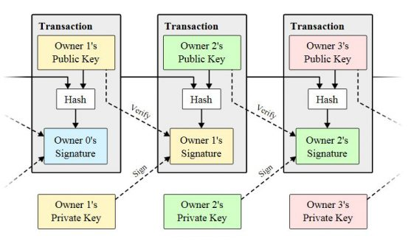
Transactions are done by signing the hash of the last transaction and the public key of the new owner of the coin.

Slide 4
How blocks are mined
Based on Adam Back's Hashcash.
SHA1, SHA256 or SHA3.
Each block uses the hash of the previous block
Combine it with a nonce which is provided by the miner’s CPU power
Specified number of 0’s set by the block-chains difficulty.
Target solution rate is 2016 blocks being validated every 2 weeks

Slide 5
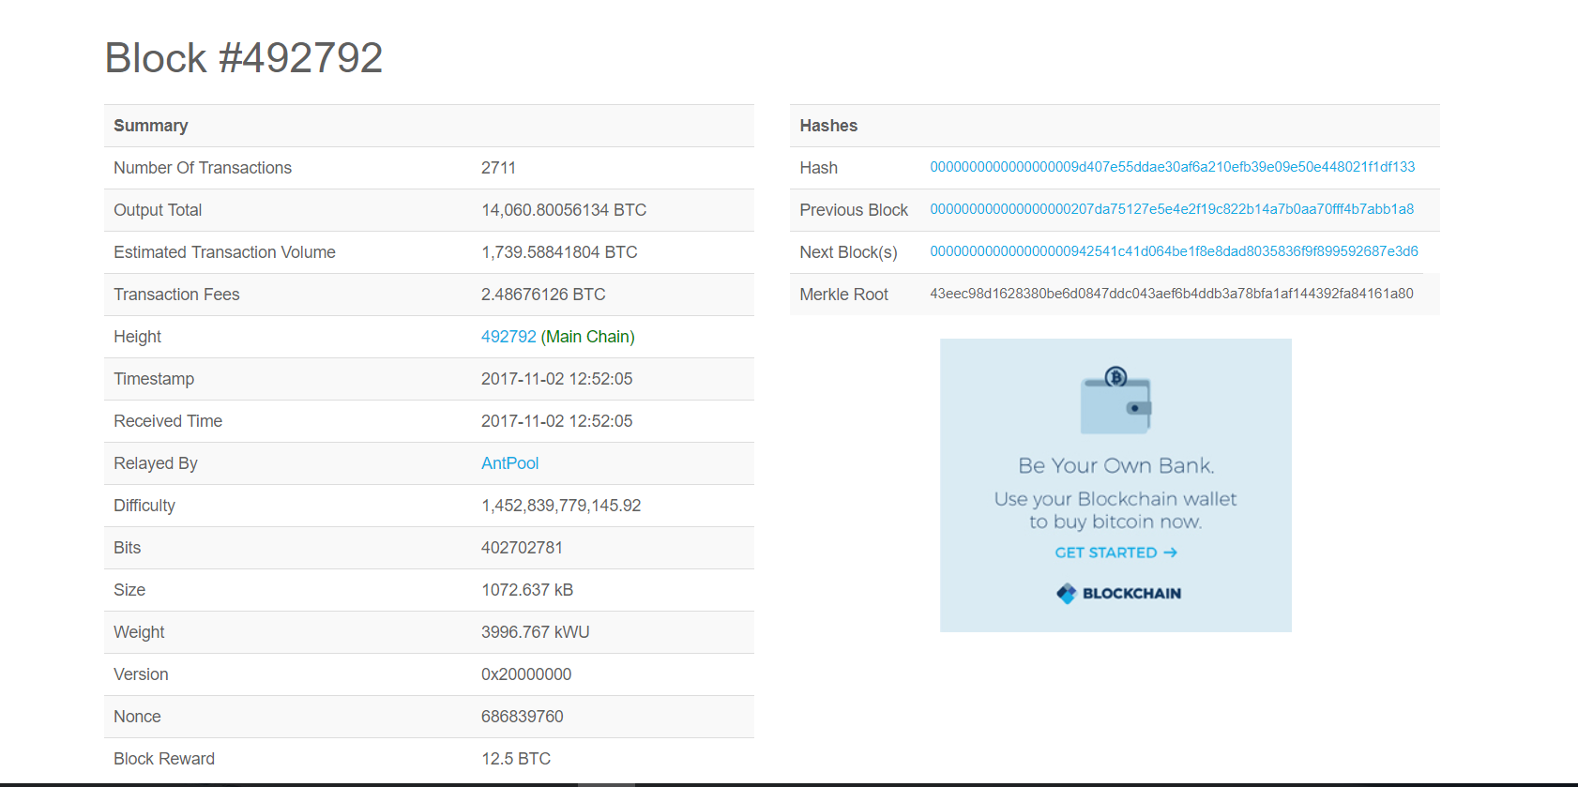
Two Content Layout with Table

Slide 6
Historic Bitcoin Events
By observing the effects of major events through-out bitcoins history we can see can get a better insight into bitcoins reliability in the future.

Slide 7
Milestones in bitcoins lifespan
The first block made on the 3 January, 2009.
Then on October 5, 2009 the New Liberty Standard give a value of 1,309.03 BTC to 1.00 dollar.
Laszlo Hanyecz used 10,000 BTC to purchase two pizzas and have them delivered to a house.
On February 9, 2011 bitcoin reaches value of 1.00 dollar per coin.

Slide 8
Bitcoins association with crime
On June 1, 2011 Gawker covered the illegal market The Silk Road.
TOR.
On October 1, 2013 Ross Ulbricht arrested.
US senate hearing on November 18, 2013 would lead to a price jump from 685.75 to 1072.83 dollars.
On June 27, the 30,000 seized auctioned back onto the marketplace by US Marshals in batches of 3000.

Slide 9




Major companies that accept bitcoin
DELL – July 18, 2014
Wordpress - November 15, 2012
Overstock.com -
Microsoft - December 11, 2014

Slide 10
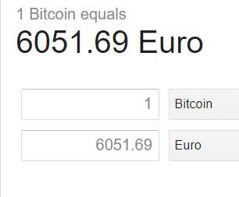
Bitcoin price as of 02/11/2017
Continues to grow thanks to..
User Anonymity
No Third-party Interruptions
Very Low Transaction Fees
Mobile Payments

